Slide 1

Introduction to
Objective:
Brief background
Try to cover a broad range of topics that will get you familiarise with Python in no time
Python is my absolute favourite
What is Python?
Programming language
Medium for people to communication with computers
Set of rules and vocabulary for instructing a computer to perform tasks
High level, general-purpose programming language
Programmer friendly: easy to write/read/understand/debug/maintain, platform independent
Language constructs and object oriented approach help programmers to write clear, logical code even for complex and large scale projects
Designed by Guido Van Rossum and named it after BBC TV show Monty Python’s Flying Circus.
Extremely popular in the growing field of data science.
Instagram, Dropbox and original creators of Youtube.

Slide 2
;
Why Python ?
It is easy to read and write
- without indentation your code even won’t run.
Interpreted language -
- You don’t need to manually compile your program
- Many languages require a manual compilation step before you can run program
- Python compiles your code into low-level code, i.e. bytecode.
Dynamically typed
Many languages require variable declaration
e.g. in Java
String Name = “Nick”;
int Age = 37;
float Salary = 1250.70;
In Python you can do
e.g.
name = ‘Nick’
age = 37
salary = 10000
python dynamically finds out type of the variables
Annual_income = 12* salary
name_repeat = name * 3 (works in Python, but not in other languages)

Slide 3
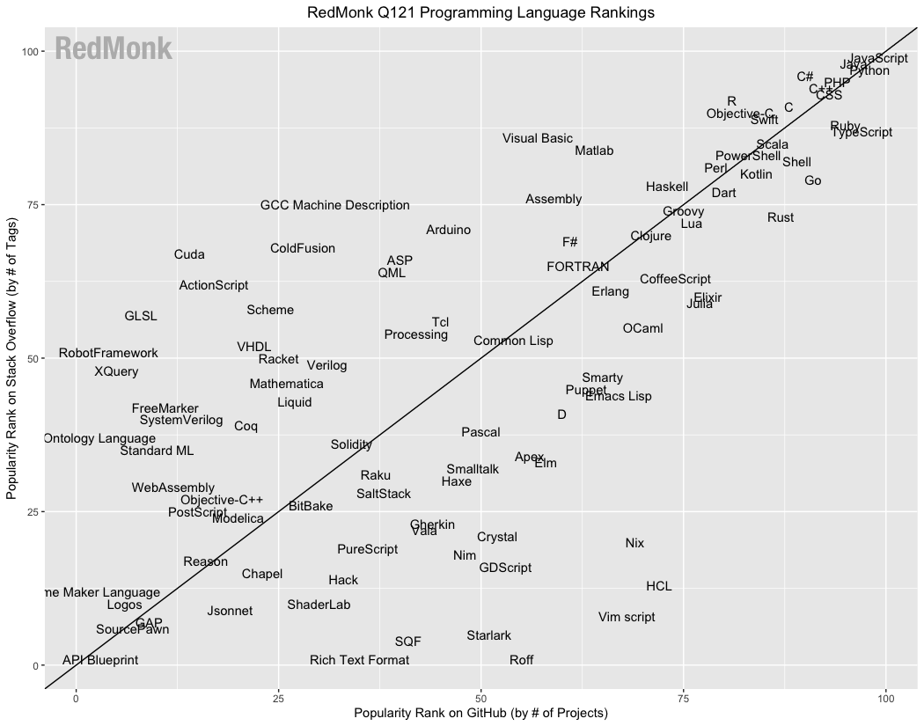
Popularity:
The most popular programming language in the world
https://spectrum.ieee.org/top-programming-languages-2021
https://www.tiobe.com/tiobe-index
https://redmonk.com/sogrady/2021/03/01/language-rankings-1-21/
https://redmonk.com/sogrady/2021/03/01/language-rankings-1-21/

Slide 4
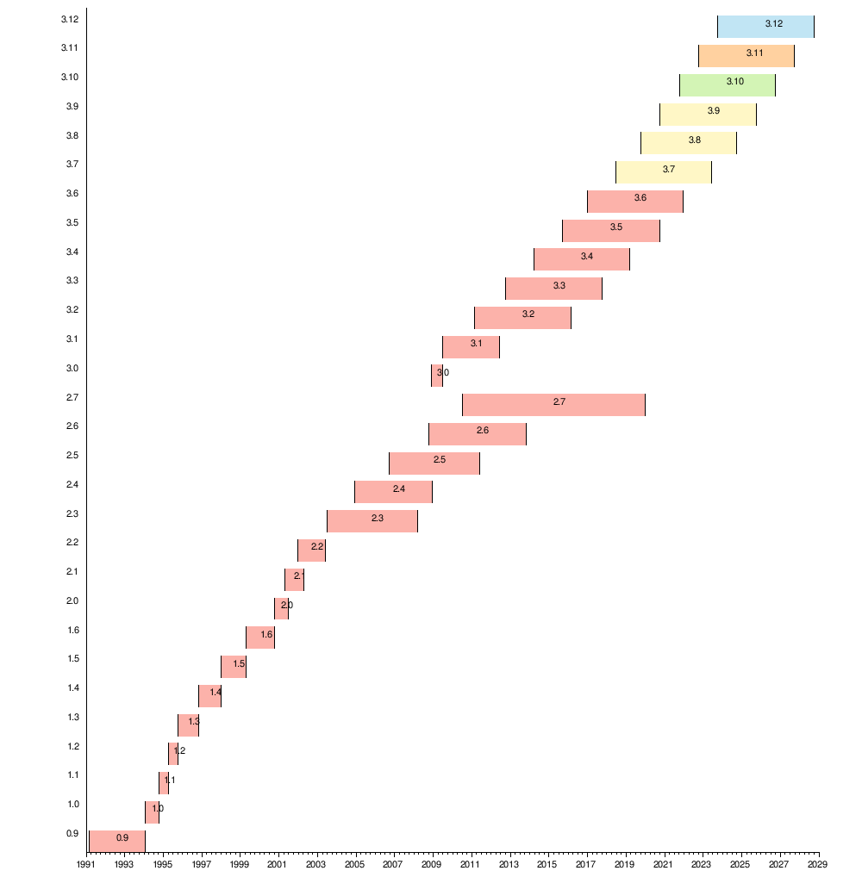
Python Popularity
Popularity is great advantage
Vast amount of resources: books, courses, sample code, help
Google trends: https://trends.google.com/trends/explore?date=all&q=Python
Python will be here for a while, learning is safe bet & of course better pay scale
Python History
Source: https://en.wikipedia.org/wiki/History_of_Python

Slide 5
Which Python IDE ?
VSCode
https://code.visualstudio.com/
Spyder
Atom
https://atom.io/
Jupyter Notebook
Obvious choice for data people. Why?
Many more

Slide 6
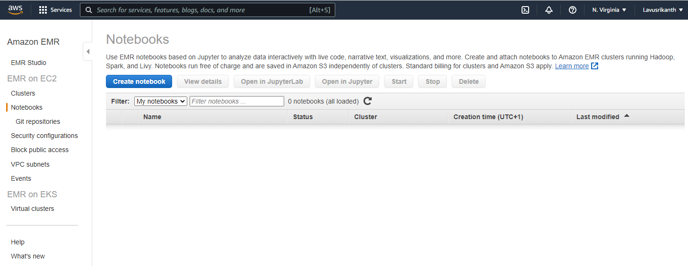
AWS EMR Notebooks

Slide 7
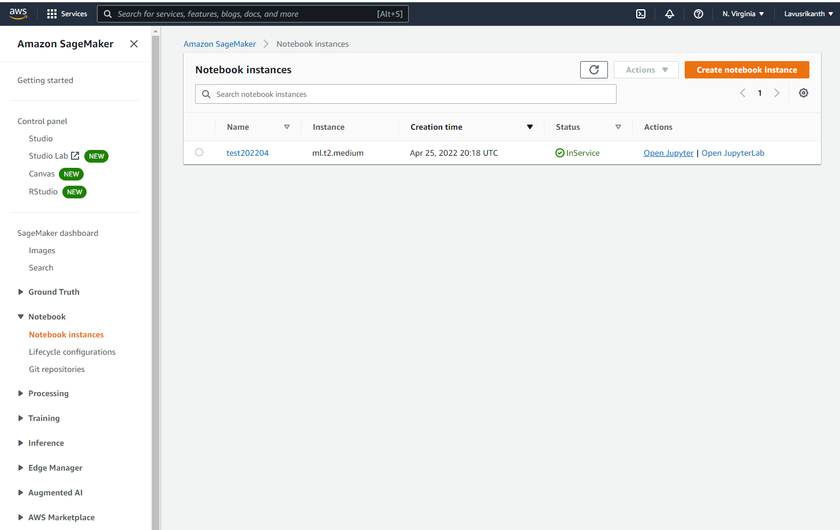
AWS Sage Maker Notebooks-1

Slide 8
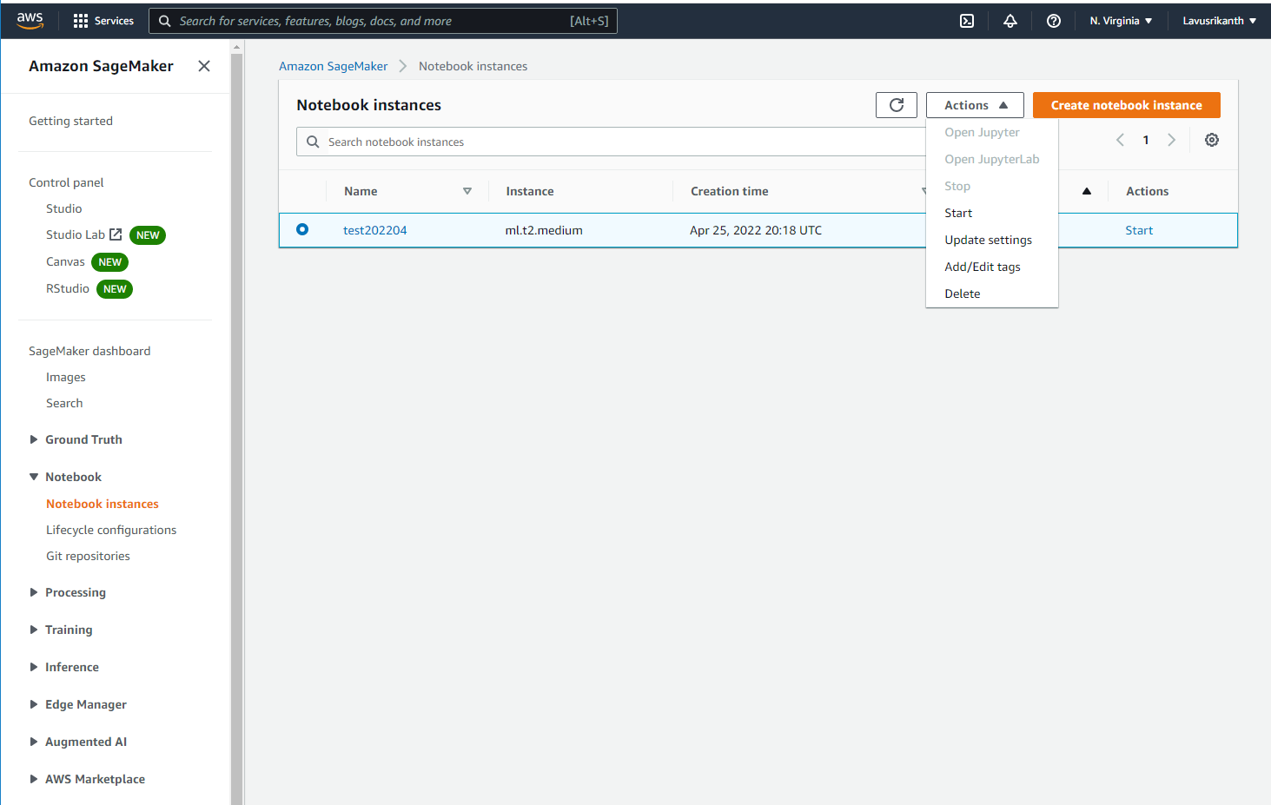
AWS Sage Maker Notebooks-2

Slide 9
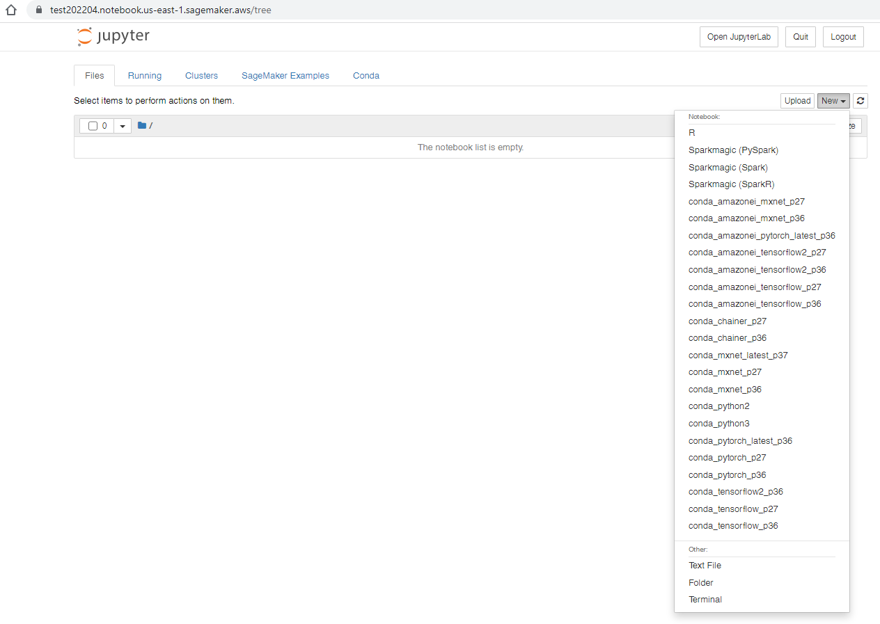
AWS Sage Maker Notebooks-3

Slide 10
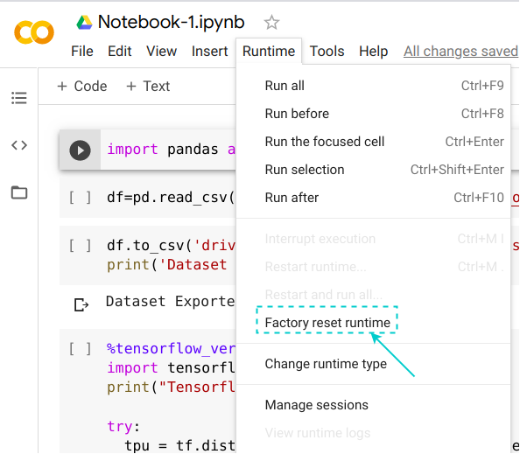
Google CoLab - https://colab.research.google.com/notebook

Slide 11
Python Data Types
Python provides several native data types to store and process data.
These are essential building blocks that you need to know well
Effective solutions require right data type selection depending on problem.
Numbers
Integers
Floating point numbers
Complex numbers
Booleans
Has only two values
True – 1 or non zero
False – 0
Strings
Lists
Dictionaries
Tuples
Sets
Ranges. ranges are efficiently calculated on the fly

Slide 12
Mutability in Python
Python data types can be categorized into two classes
Mutable: An object is mutable if we can change data it holds
Lists, Dictionaries and Sets
Immutable: An object is immutable if we can not change it
All numbers (integers, floats, complex numbers)
Booleans
Strings
Tuples

Slide 13
Python operators
Python arithmetic operators
Addition: +
Subtraction: -
Multiplication: *
Division: /
Floored division(integer division): //
Modulus: %
Python Conditional/ comparison operators
Less than : <
Less than or equal to: <=
Equal to: ==
Greater than : >
Greater than or equal to : >=
Not equal to !=
Python Logical operators
And : returns first false value
Or : returns first true value
Not : flips Boolean value of the operand

Slide 14
Python constructs
- Conditional statements
- Looping constructs

